Slide 1

Marketing Plan
By Kayla Canfield

Slide 2
Mission Statement
To preserve and interpret the historic Pennsylvania German farmsteads, collections, and landscapes, offering unique, educational experiences that connect visitors with Renfrew’s rich heritage.

Slide 3
Marketing Goals
Increase visitor numbers by 20% year-over-year.
Boost social media followers by 50% within the next 12 months.
Host at least 4 major family-centered events per quarter.

Slide 4
Marketing KPIs
Visitor count, ticket sales, and event attendance.
Social media engagement metrics (likes, shares, comments).
Revenue generated from events and merchandise.

Slide 5
Target Audience
Families with children, history enthusiasts, local community, school groups, tourists.

Slide 6
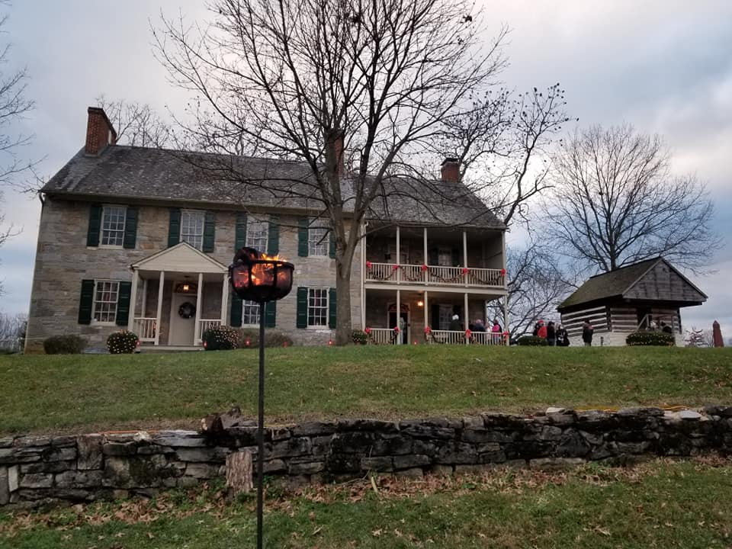
Audience Personas
History Harriet: A teacher who loves bringing her class to historical sites.
Family Frank: A local parent seeking educational outings for kids.
Tourist Terry: A visitor interested in cultural and historical sites.

Slide 7

Situational Analysis
Analysis of current market position, visitor trends, and competitive landscape.

Slide 8

SWOT Analysis
Strengths: Rich history, diverse collections, community support.
Weaknesses: Limited awareness outside the local area.
Opportunities: Growing interest in historical and cultural tourism.
Threats: Competition from other attractions, changing visitor interests.

Slide 9

Marketing 4P’s
Product: Unique historical experiences, educational programs, events.
Price: Competitive ticket pricing, discounts for groups and locals.
Place: Renfrew Museum and Park, enhanced online presence.
Promotion: Social media campaigns, local partnerships, events.

Slide 10

Pricing Strategy
Balanced approach: Affordable for families, with premium options for special tours and events.

Slide 11

Marketing Initiatives
Launch Family History Days with interactive activities.
Partner with local schools for educational programs.
Seasonal events showcasing the farmstead's history.
Health & Wellness program --Utilize the park's natural setting for wellness activities like yoga, meditation, or guided nature walks.

Slide 12

Marketing Channels
Social media (Facebook, Instagram, Twitter).
Local media partnerships (newspapers, radio).
Collaboration with travel blogs, travel vlogs and tourism websites.

Slide 13

Marketing Responsibilities
Assign roles for social media management, event planning, and community outreach.

Slide 14

Marketing Technology
Utilize social media scheduling tools.
Develop a more interactive website with virtual tours.
Implement a CRM system for visitor data analysis.

Slide 15

Editorial Calendar
Monthly themes based on historical events or seasonal activities.
Regular social media posting schedule.

Slide 16

Marketing Budget
Allocate funds for social media advertising, event production, and technology upgrades.

Slide 17
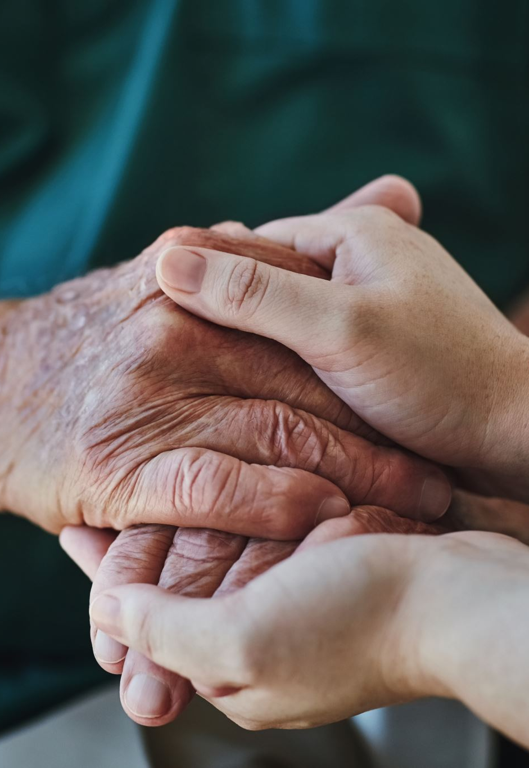
Additional Considerations
Community Engagement: Encourage local involvement through volunteer programs and local history projects.
Educational Institutions: Partner with universities for research projects or internship programs.

Slide 18
Summary
This plan is designed to boost Renfrew Museum and Park’s visibility, engage the community, attract more visitors, and increase revenue through a focused, strategic approach to marketing and events.

